Slide 1

Speech Emotion Recognition (Classification) in real-time using Deep LSTM layers
Submitted in partial fulfilment of the requirement for the award of the degree of
BACHELOR OF TECHNOLOGY
IN
COMPUTER SCIENCE & ENGINEERING
Submitted by:
Ishika Gupta 2016787
Rohan Pandey 2016967
Yuganshu Joshi 2017147
Under the Guidance of
Dr. Ashwini Kumar Singh
Associate Professor
Project Team ID: MP23CSE152
Department of Computer Science and Engineering
Graphic Era (Deemed to be University)
Dehradun, Uttarakhand
September-2023

Slide 2
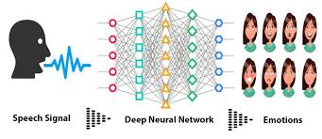
INTRODUCTION
Human communication is inherently rich with emotional content, and the ability to understand and classify these emotions from spoken language.
Speech Emotion Recognition (SER) has received great attention in recent years due to its many applications, from the development of human-computer closely related to customer service in call centers
This research focuses on the development of a real-time Speech Emotion Recognition (SER) system, specifically designed to classify emotions expressed in spoken language.

Slide 3
PROBLEM STATEMENT
Enhanced Customer Service:
Speech emotion detection using LSTM deep learning can improve customer service by analyzing customer interactions, leading to more emotionally intelligent responses and better understanding of customer needs.
Human-robot Interaction:
Integrating emotion recognition in robots or virtual assistants fosters more natural and emotionally aware interactions, making these technologies more engaging and adaptable to the emotional needs of users.
Applications in Mental Health and Communication:
By automating the recognition of emotions in speech, this approach can contribute to applications in mental health monitoring, virtual assistants, and communication technologies

Slide 4
LITERATURE SURVEY
Here is an overview of some key research findings and trends in the literature :
Datasets:
Several publicly available datasets have played a crucial role in advancing SER research. Examples include the IEMOCAP, EmoReact, and RAVDESS datasets, each containing a variety of emotional expressions.
Transfer Learning:
Transfer learning, using pre-trained models on large datasets (e.g., ImageNet), has been explored to improve SER performance.
Ethical Considerations:
Privacy and ethical concerns related to the collection and use of emotional data have gained attention in SER research. Ensuring user consent and data security are important aspects

Slide 5
OBJECTIVE
The objectives of the proposed work are as follows:
Develop a Real-time Speech Emotion Recognition (SER) System.
Utilize Deep LSTM Layers.
Achieve High Emotion Classification Accuracy.
Facilitate Practical Applications.
Optimize for Real-time Constraints.

Slide 6
METHODOLOGY
Datasets used in the speech emotion detection using LSTM:
RAVDESS Database
A RAVDESS filename consists of a 7-part numerical identifier (e.g., 03-01-06-01-02-01-12.wav).
RAVDESS contains 1440 files: 60 trials per actor x 24 actors = 1440.
Speech emotions includes calm, happy, sad, angry, fearful, surprise, and disgust expressions.
TESS Database
There are a set of 200 target words were spoken in the carrier phrase.
There are 2800 data points (audio files) in total.

Slide 7
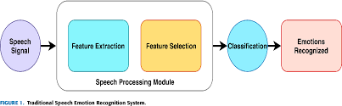
Various Phases of the Project
The Various phases in the process of creating speech emotion detection using LSTM includes:
Data Preprocessing
Feature Extraction
Model Definition & training
Model Evaluation

Slide 8
Data Pre-Processing & feature Extraction
Data Pre-processing includes :
Normalization: The 'AudioSegment' object is normalized to + 5.0 dBFS, by effects module of pydub.
Transforming the object to an array of samples by numpy & AudioSegment.
Trimming the silence in the beginning and the end by librosa.
Padding every audio file to the maximum length by numpy, for length equalization.
Noise reduction is being performed by noisereduce.
Feature Extraction includes:
Energy - Root Mean Square (RMS)
Zero Crossed Rate (ZCR)
Mel-Frequency Cepstral Coefficients (MFCCs)

Slide 9
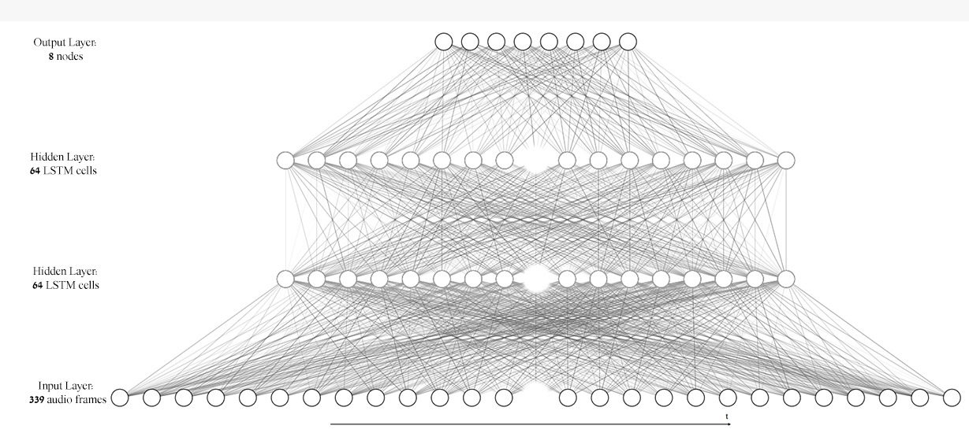
Model Definition & Training
The model is executed with keras library, using 2 hidden LSTM layers with 64 nodes, and an output (dense) layer with 8 nodes, each for one emotion using the 'softmax' activation. The optimizer that led to the best results was 'RMSProp' with default parameters.
The batch size chosen is 23, which is a factor of all samples in the sets; train (3703), validation (368) and test (161).

Slide 10
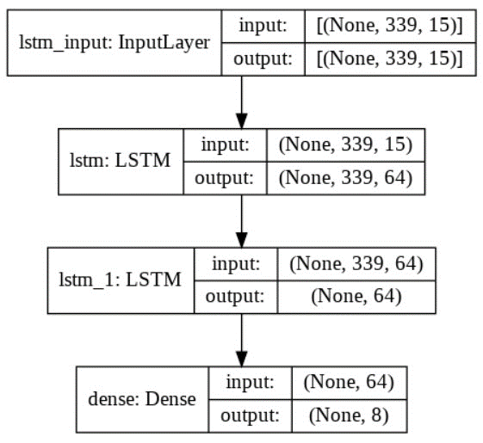
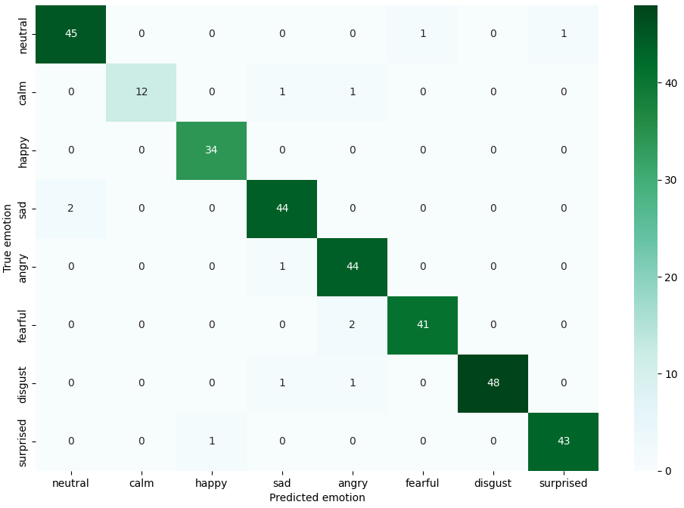
MODEL EVALUATION
The model has been evaluated using the following factors:
A visualization of the loss and cateogorial accuracy values trend during the train process.
A confusion matrix for visualizing the number of successful predictions of each emotion: for validation and test sets.
Model's prediction accuracy rates for each emotion: for validation and test sets.

Slide 11
RESULT AND CONCLUSION
The validation set accuracy of the model had come up to 97.97% and the test set accuracy had reached 96.28% with overfitting in the training process starting around the 200th epoch. Although various regulations have been placed in earlier tryouts, they had restricted the accuracy from reaching its maximum value.
Within the next part of the study in which the model will be used as a Real-time SER, The inputs will be processed similarly as the data used by the model, to gain similarity and therefore, precision.

Slide 12
THANK YOU

